Slide 1
Detection and Identification of Pool Balls using Computer Vision
Simon Have & Jesper Bækdahl

Slide 2
Agenda
Introduction
Human Interaction Detection
Ball Detection
Ball Identification
Test and Conclusion

Slide 3
Introduction
System overview:

Slide 4
Human interaction detection
Why detection?
Inclined to be ”paranoid” towards detection.
False postive
Type I
False negative
Type II

Slide 5
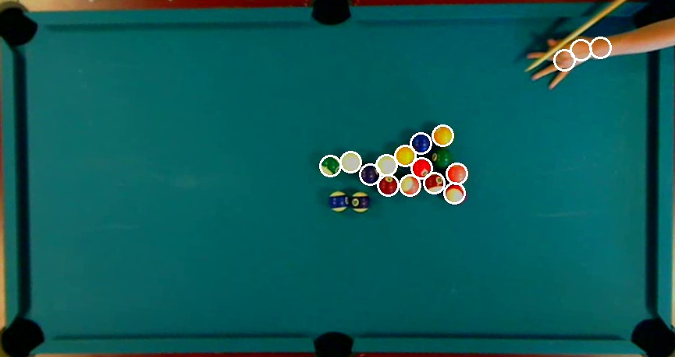
Human interaction detection
Without:

Slide 6
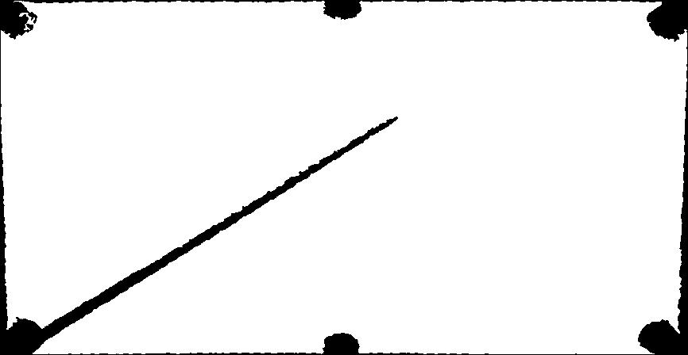
Human interaction detection
Occlusion factors:
Area and Perimeter.
Perimeter-factor > Threshold
Area-factor < Threshold

Slide 7
Human interaction detection
Add video

Slide 8
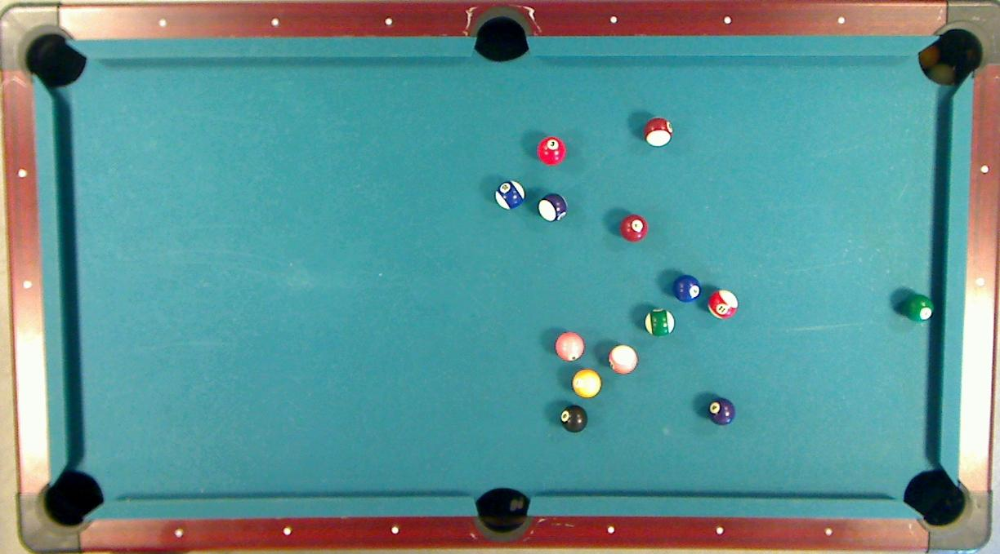

Slide 9
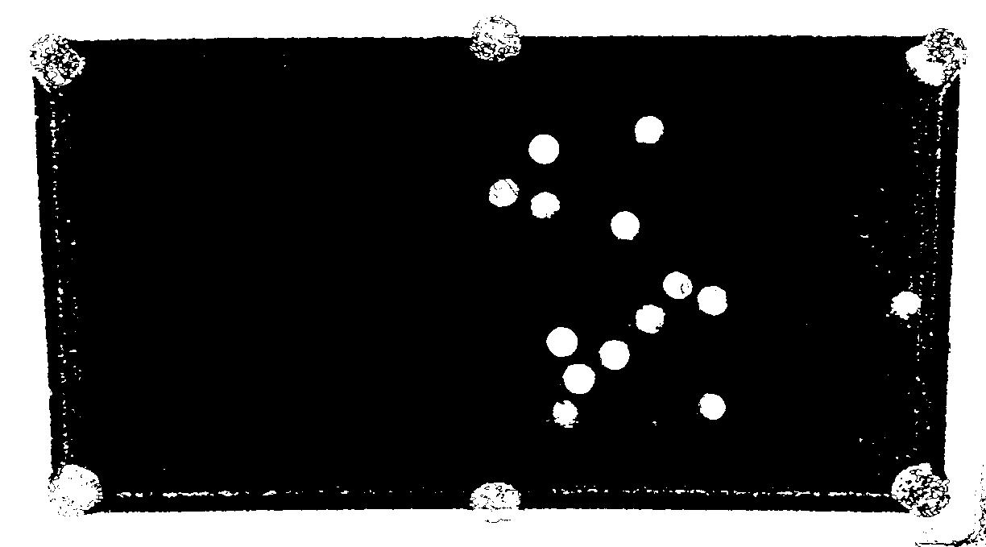
Ball Detection – Preliminary segmentation

Slide 10
Ball Detection – Probability estimation
24%
93%

Slide 11
Ball Detection – Best Candidates Selection
96%
98%

Slide 12
Ball Detection

Slide 13
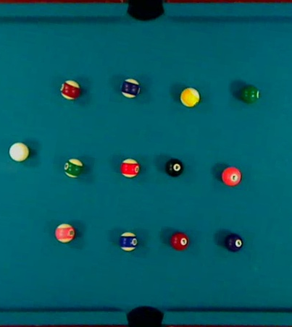
Ball identification - Calibration
Select Balls
Compute mean RGB

Slide 14
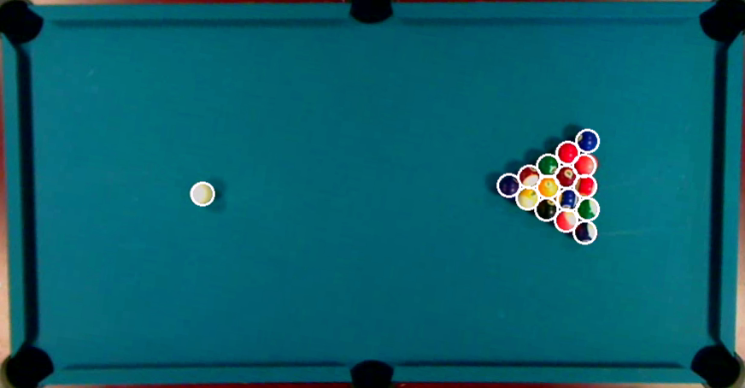
Ball Identification -

